Slide 1
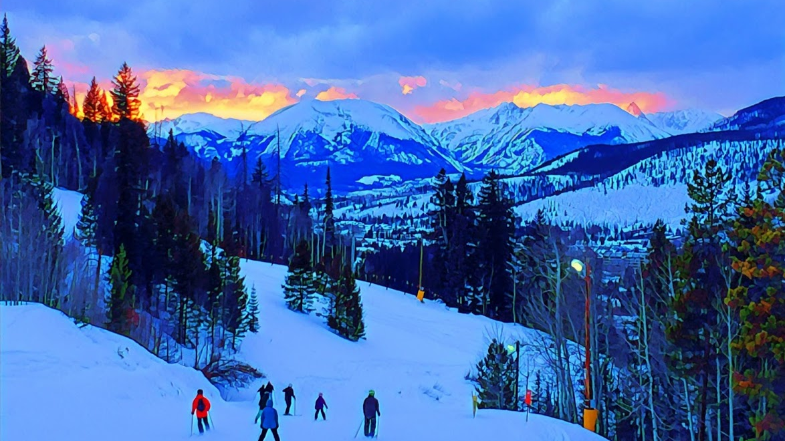
Old AJ’s Snow Prediction Almanac
University of Denver Data Analytics and Visualization Bootcamp
Project 1
AJ Hibshman

Slide 2
Project Overview
Every year the Farmer’s Almanac comes out with a prediction of winter weather. This is eagerly awaited by all snow sports enthusiasts. My aim is to search for potential early lead time predictors of what a coming winter may hold in terms of snowfall for the north-central Colorado mountains. This may aid potential vacation planning or season pass purchases
Null Hypothesis: there is no correlation between each factor and seasonal snowfall
Alternative Hypothesis: One or more factors has a statistically significant impact on seasonal snowfall.

Slide 3
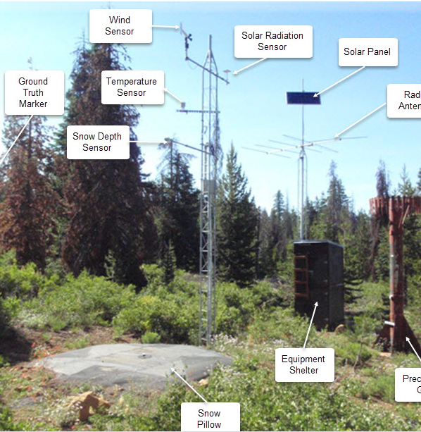
Data Sources
Snowfall and weather historical data was collected from a set of snotel sites in Colorado. These automated sites measure snowfall and a variety of other weather information. I will select a sample of these sites in the region of interest that have sufficiently long data history. This data is available via the NRCS report generator.
Additional sources included the National Weather Service Climate Prediction Center for large scale climate factors (ENSO/ PNA) and https://www.pro-football-reference.com/ for Broncos data.

Slide 4
Data Retrieval and Compilation
Snow Water Equivelent was chosen as the metric to evaluate snowfall as this had the longest data history amongst the greatest number of snowtel sites. Reports were run to get max seasonal SWE and average SWE for Dec 25th and March 1st of each ‘Water Year’
Temperature and precipitation data for prior August and September were collected for analysis.
Additional large scale climate factors were retrieved:
ENSO (El Nino Southern Oscillation) using a three month Oceanic Nino Index for prior July-September.
Measures warm and cool phases over tropical pacific
Pacific / North American pattern using prior September’s measurement
Associated with variation in the east Asian jet stream

Slide 5

Panda DataFrames
Two Jupyter notebooks were created for this project, one for analysis of SNOTEL sites themselves and presentation with gmaps API, and another for statistical analysis of the independent variables.
DataFrames were created in pandas by importing data via CSV’s.
Some merging and cleaning of data was performed to enable analysis.

Slide 6
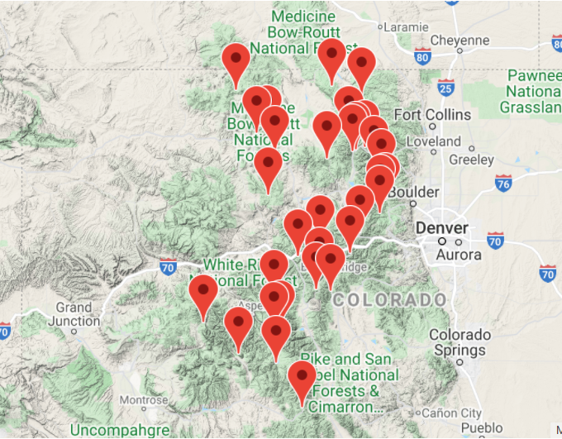
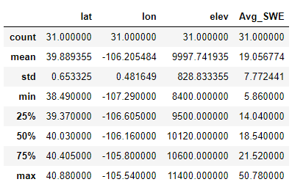
Characteristics of Data Set:

Slide 7
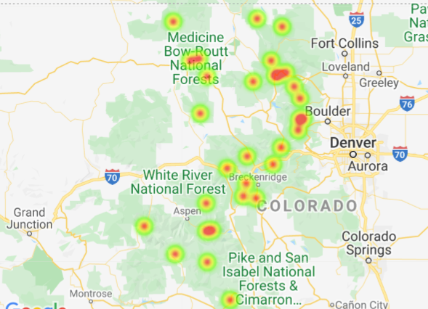

Slide 8
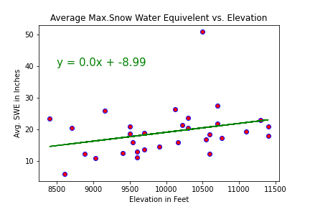
Elevation vs. Avg. SWE
The Correlation between Elev. and SWE is 0.3
Slight positive Correlation of elevation to snowpack.

Slide 9
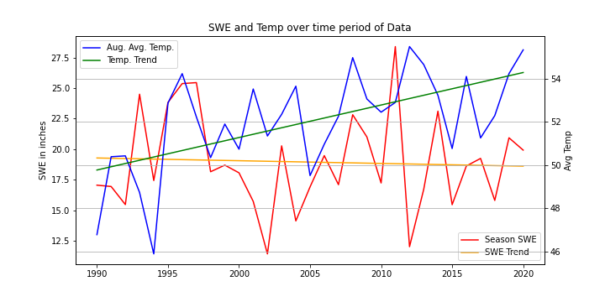
Snowfall and Temperature Trends Over Time
The Correlation between Temperature and Time is 0.6

Slide 10
Analysis

Slide 11
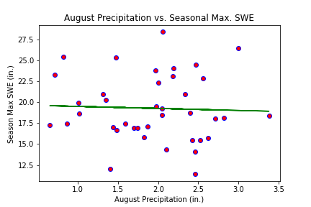
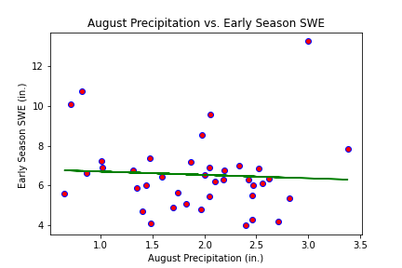
August Precipitation
The Correlation between August Precip and Total Season SWE is -0.04
The Correlation between August Precip and Early Season SWE is -0.06

Slide 12
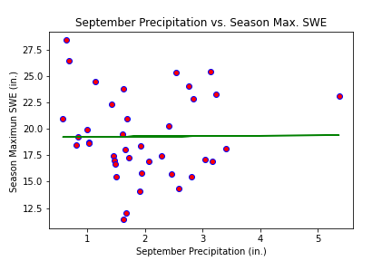
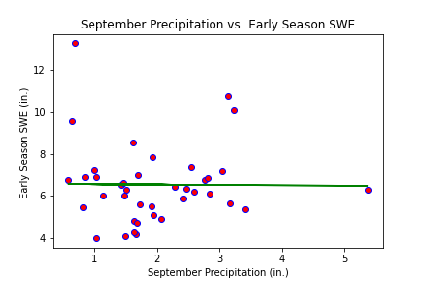
September Precipitation
The Correlation between September Precip and SWE is 0.01
The Correlation between September Precip and Early Season SWE is -0.01

Slide 13
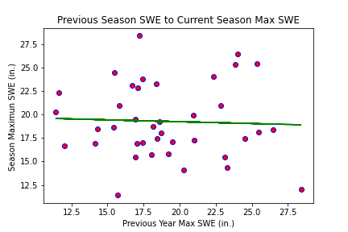
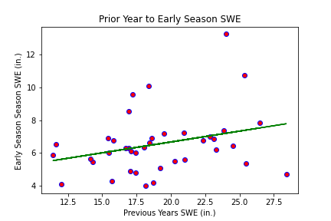
Prior Year’s SWE
The Correlation between Prior and Current Year is -0.04
The Correlation between Prior and Early Season is 0.29

Slide 14
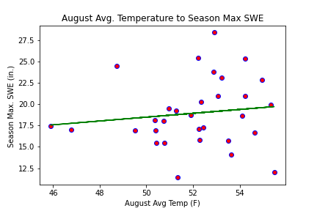
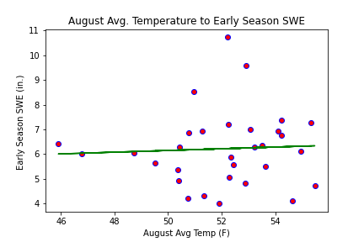
August Average Temperature
The Correlation between Aug Temp and Season Snowfall is 0.13
The Correlation between Aug Temp and Early Season Snowfall is 0.05

Slide 15
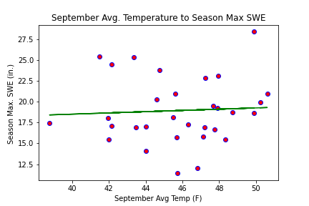
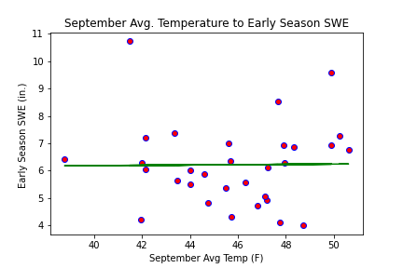
September Average Temperature
The Correlation between Sep Temp and Season Snowfall is 0.06
The Correlation between Sep Temp and Early Season Snowfall is 0.01

Slide 16
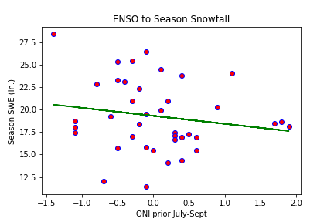
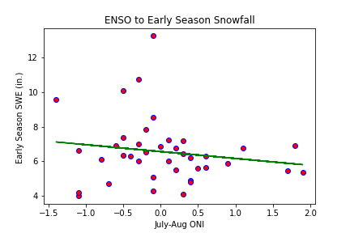
ENSO
The Correlation between ENSO and Season Snowfall is-0.17
The Correlation between ENSO (OND) and Early Season Snowfall is -0.16

Slide 17
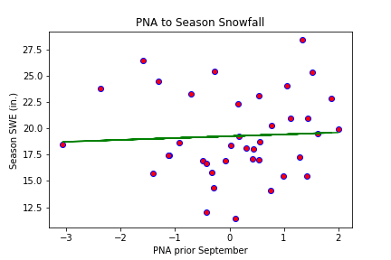
PNA
The Correlation between PNA and max. Season Snowfall is 0.05

Slide 18
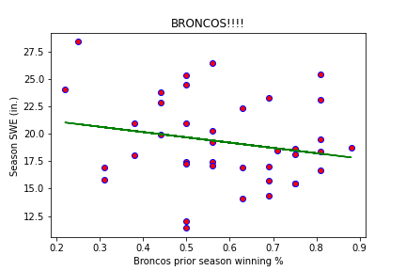
Broncos Prior Season
The Correlation between Broncos winning and max. Season Snowfall is -0.21

Slide 19

Conclusions
Most factors examined showed little to no correlation and the data largely failed to reject the null hypothesis.
The strongest r value was prior years snowfall to early season showing some tendency for strong snow totals to spill over into the next season.
ENSO showed some negative correlation indicating colder values may predict higher snowfall, however the data has high variation.
A Broncos poor season may have some correlation with stronger snowfall the following winter.
August Average Temperature shows a clear increase over time, with an r-value of .6

